Slide 1
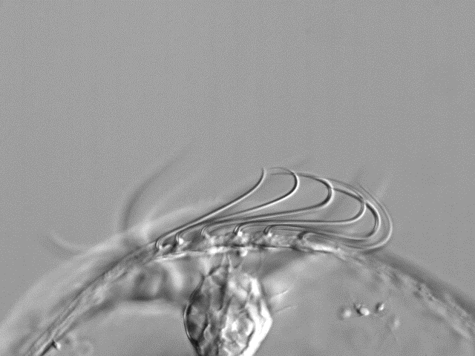
Comb plates beating
1000 fps
2 dpf
Negative geotaxis
100 µm
Positive geotaxis
The two possible pathways of a horizontally tilted animal are shown in relation to the numbers of waves visible at one time in the comb plates.
Horridge G.A., 1965

Slide 2
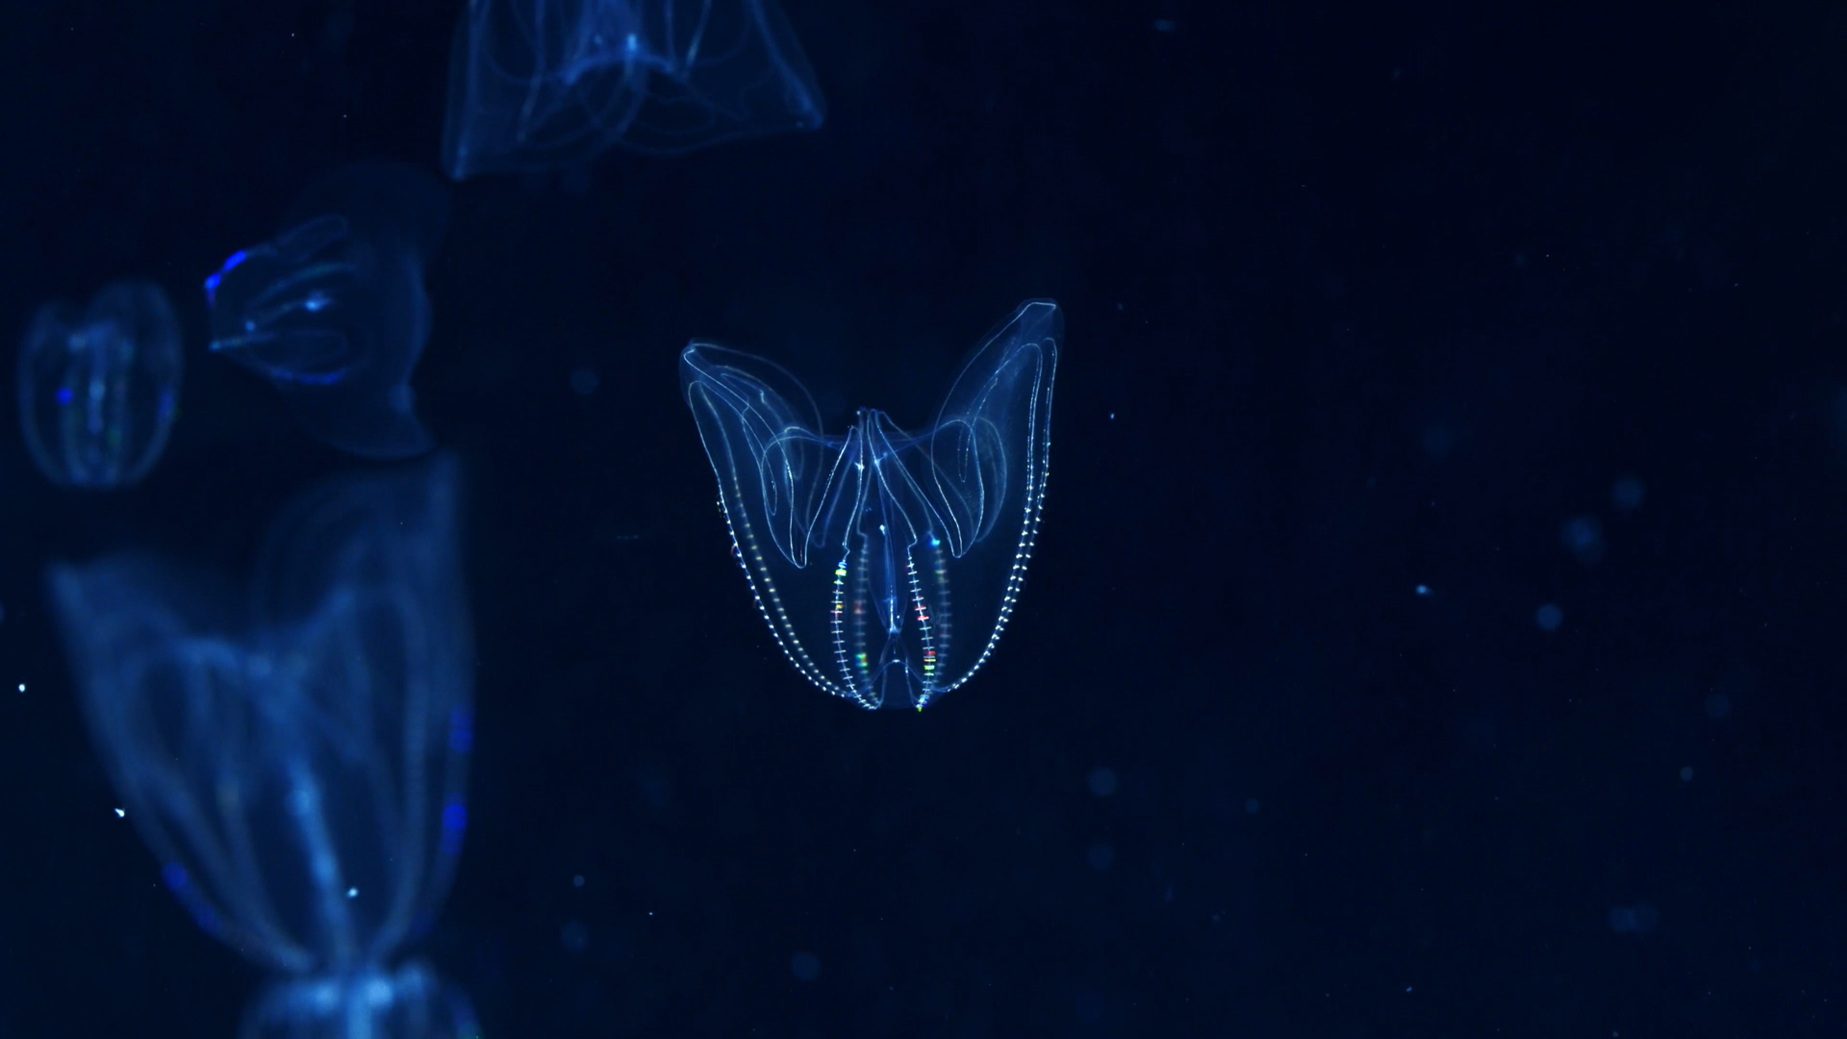
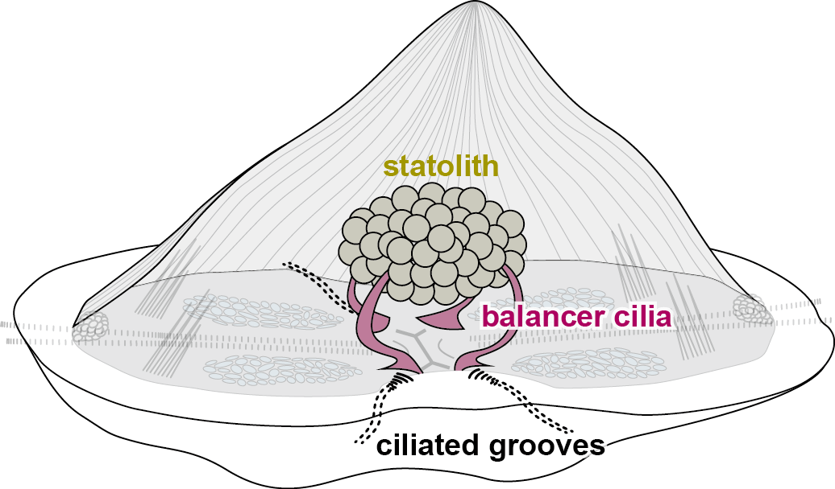
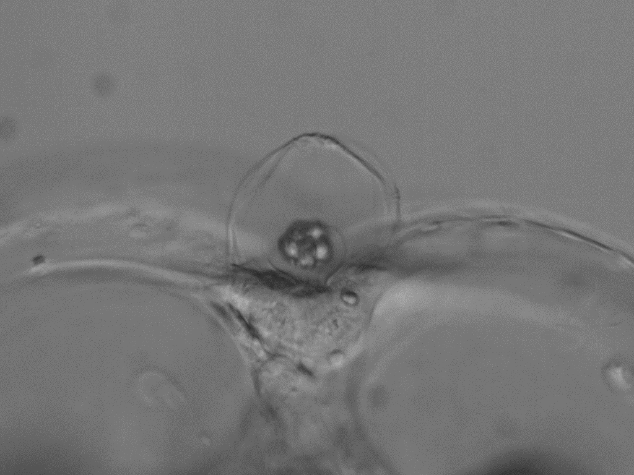
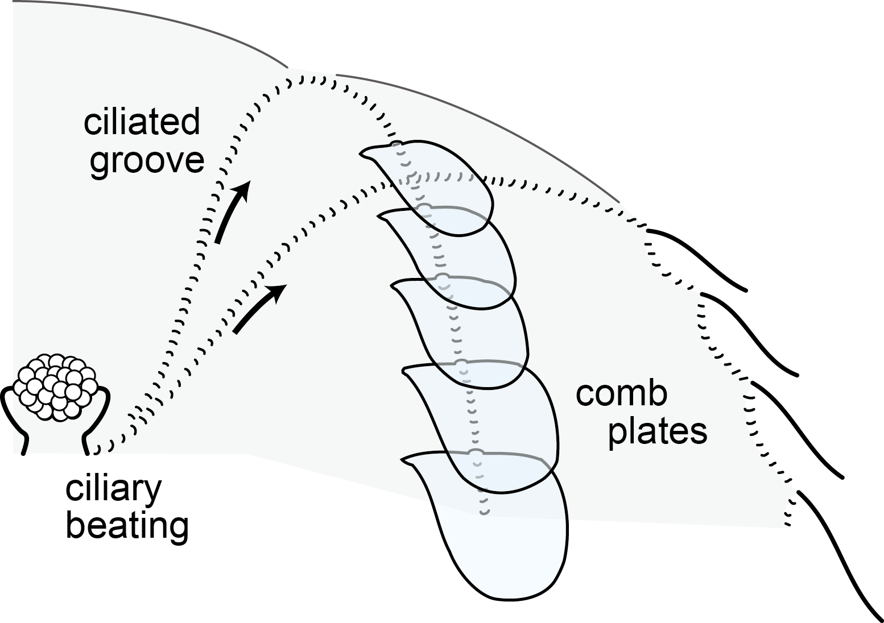
Gravity sensors function as a pacemaker for comb plate beatings
apical organ
5 cm
statolith
balancer cilia
×0.15 speed
50 µm
Tamm S.L., 1982

Slide 3
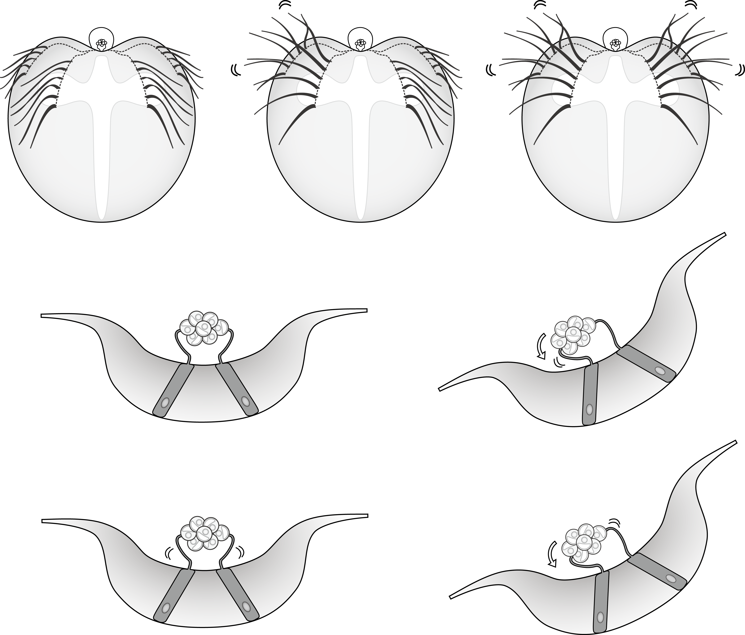
The tendency to turn up or down, “signs of geotaxis” can be switched.
Negative geotaxis
Positive geotaxis
gravity
gravity
Turn anti-clockwise!
Turn clockwise!
Tamm S.L., 1980

Slide 4
